Slide 1
Meeting #2
- DNA, RNA, proteins, the central dogma of molecular biology
- genome, genome sequence variations
- a small coding task with DNA sequence

Slide 2
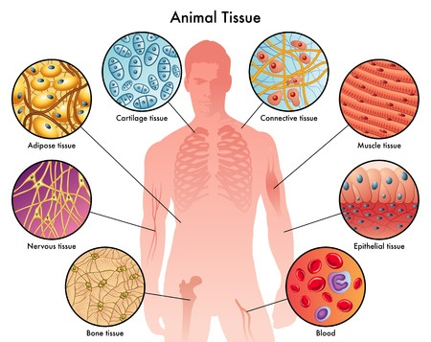
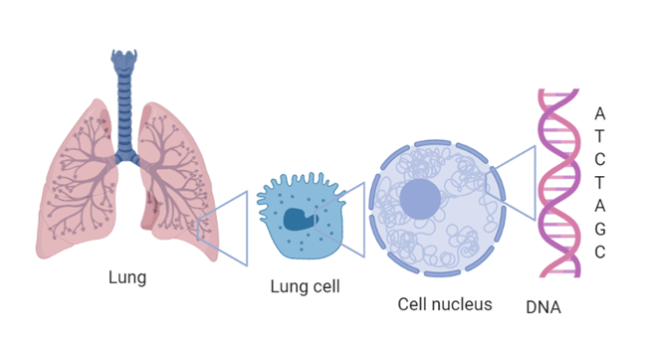
The human organism consists of nearly 37.2 trillion cells
Almost every cell contains DNA in its nucleus

Slide 3
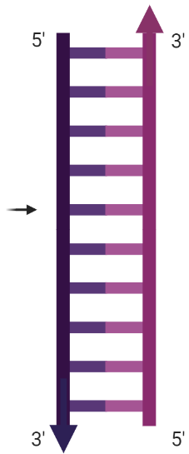

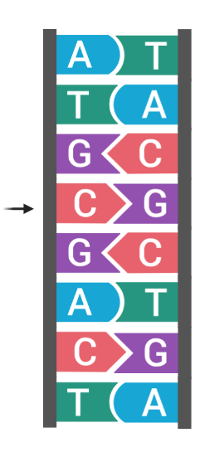
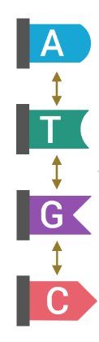
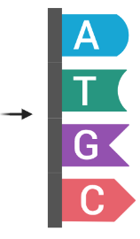
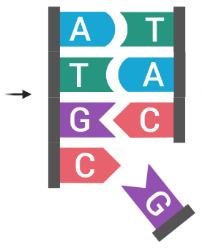


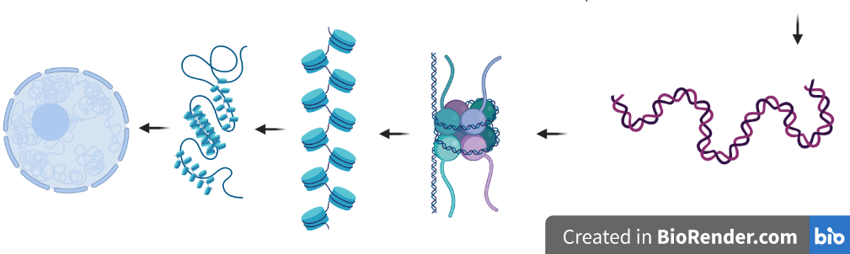
The four different nucleotides (bases) or monomers of DNA
A single stranded DNA
Bases connect with complementarity rule: A with T, G with C
A double stranded DNA
The DNA strands have reverse directionality
DNA double helix
Adenine
Thymine
Guanine
Cytosine
the chromosome
After DNA replication
Chromosome
An even tighter packed DNA before replication
Chromatin
The packed DNA inside the nucleus
DNA wrapped around “packaging” proteins

Slide 4
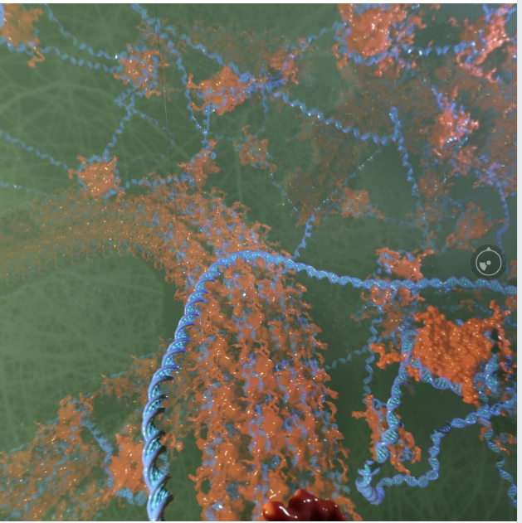
The chromatin 360 degrees by © Ribosome Studio
https://www.facebook.com/RibosomeStudio/posts/559703991189935

Slide 5
Rosalind #1 Counting DNA Nucleotides
http://rosalind.info/problems/dna/
Problem A string is simply an ordered collection of symbols selected from some alphabet and formed into a word; the length of a string is the number of symbols that it contains.
An example of a length 21 DNA string (whose alphabet contains the symbols 'A', 'C', 'G', and 'T') is "ATGCTTCAGAAAGGTCTTACG."
Given: A DNA string s of length at most 1000 nt.
Return: Four integers (separated by spaces) counting the respective number of times that the symbols 'A', 'C', 'G', and 'T' occur in s.
Sample Dataset
AGCTTTTCATTCTGACTGCAACGGGCAATATGTCTCTGTGTGGATTAAAAAAAGAGTGTCTGATAGCAGC
Sample Output
20 12 17 21
Link to my solution: https://github.com/lilit-nersisyan/bioinf-2020/blob/master/meeting_02_20200803/Rosalind%20%23dna.%20Counting%20DNA%20nucleotides.ipynb
*If you’re completely new to programming, you may find this course useful (you may join for free, if you cannot figure out how, let me know):
https://www.coursera.org/learn/python-genomics/home/welcome
** If you feel like you know what to code, but have a hard time figuring out the code syntax, you can always find answers to your questions at stack overflow:
https://stackoverflow.com/
*** you can also post your questions in “Armenian bioinformatics community” google groups

Slide 6
Rosalind #2. Complementing a Strand of DNA
http://rosalind.info/problems/revc/
Problem
In DNA strings, symbols 'A' and 'T' are complements of each other, as are 'C' and 'G'.
The reverse complement of a DNA string s is the string sc formed by reversing the symbols of s, then taking the complement of each symbol (e.g., the reverse complement of "GTCA" is "TGAC").
Given: A DNA string s of length at most 1000 bp.
Return: The reverse complement sc of s.
Sample Dataset
AAAACCCGGT
Sample Output
ACCGGGTTTT
Link to my solution: https://github.com/lilit-nersisyan/bioinf-2020/blob/master/meeting_02_20200803/Rosalind%20%23dna.%20Counting%20DNA%20nucleotides.ipynb

Slide 7
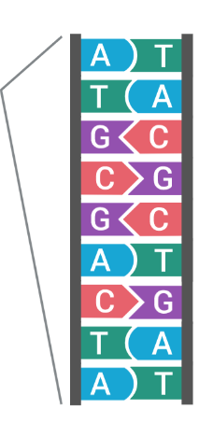
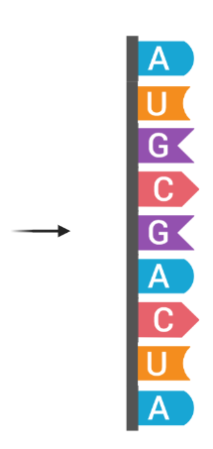
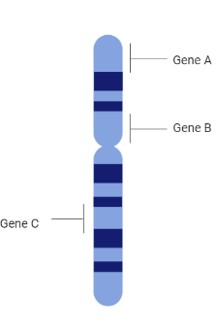
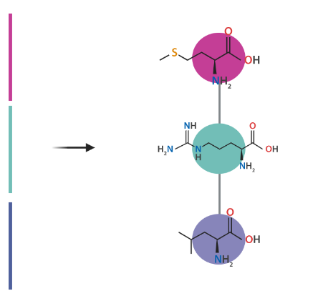
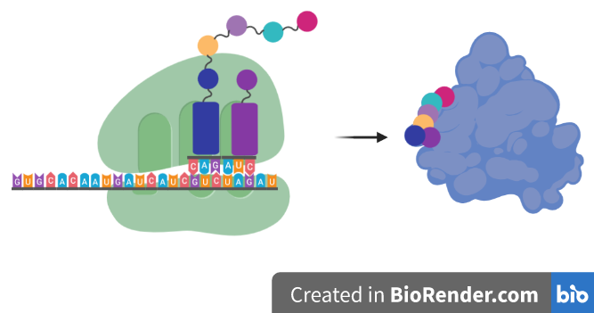
The central dogma of molecular biology (gene -> protein)
Amino acid (Met)
Codon (AUG)
Proteins are chains of monomers called amino acids.
There are 20 different types of amino acids.
During protein synthesis (translation), every triplet of nucleotides (codon) on mRNA are converted into amino acids. There is many to one mapping of codons to amino acids.
Codon (CUA)
Genes are fragments on
DNA that code for certain products, such as proteins
Amino acid (Leu)
DNA sequence is firsted copied into a single stranded messenger RNA (mRNA) during a process called transcription.
RNA has almost the same structure as DNA, but instead of T (thymine) there is U (uracile). There are also chemical differences, which we don’t discuss.
Task #4 Rosalind
Transcribing DNA into RNA
http://rosalind.info/problems/rna/

Slide 8
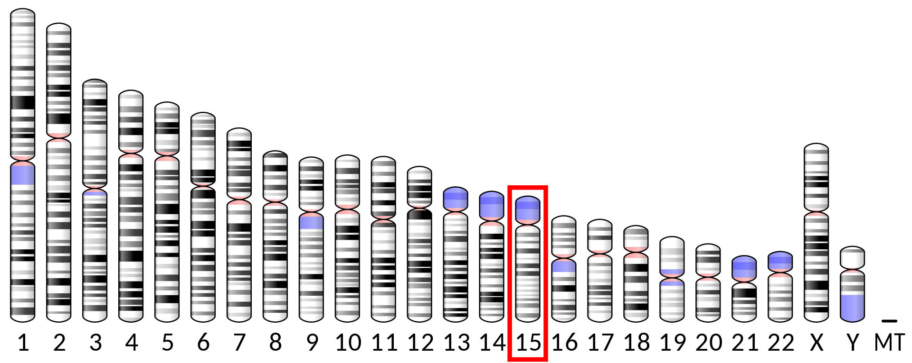
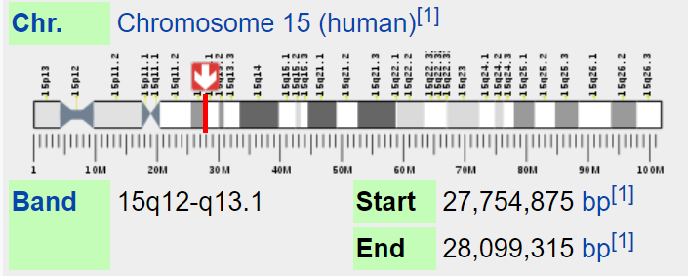
Genes, genome and the chromosomes
DNA is fragmented into chromosomes.
Humans have 23 pairs of chromosomes in the nucleus.
Each chromosome contains fragments of DNA that code for specific products. Those fragments are called genes.
Each gene has a specific location in a chromosome. Commonly, all the individuals in a species have the same order and arrangement of genes in their chromosomes.
The insulin encoding gene (INS)
Task #2
Find the ACE2 gene in the GDV.
Where is it located (chromosome and coordinates)?
OCA2 the gene shaping the eye color
The DNA sequence in all the chromosomes is called the genome.
The human genome is composed of more than 3 bln bases.
Task #1.
Find this gene in the NCBI Genome Data Viewer (GDV):
https://www.ncbi.nlm.nih.gov/genome/gdv/

Slide 9
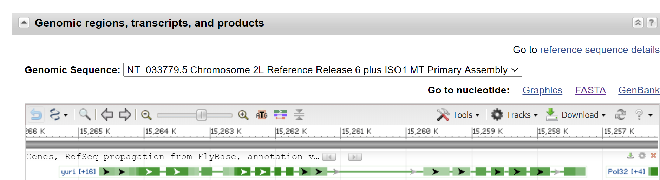
The FASTA format for sequences
The NCBI Gene database: https://www.ncbi.nlm.nih.gov/gene/
Gene #1. Yuri gagarin
https://www.ncbi.nlm.nih.gov/gene/34894
In FASTA format, each sequence has a header starting with ‘>’, followed by the actual sequence. They may be many sequences in a single FASTA file.
FASTA files may have extensions .fasta or .fa or .fna
>NT_033779.5:c15264692-15257267 Drosophila melanogaster chromosome 2L
TCAGTTCGGTTTCGTTGGCGATCGCGAACGGAGCGCAGACGAAACGCGCGGTATTTGGATCGTGGCAAGA
AATAAAAACAACAACATGCTGAAACCGTATACTTAATACGCGTGTGTGTAGCTCAAAAACAAGAAAAATA
TAAATAAACAAAACTACATTGCTACGTCAGAAGACTGCAAACAAAAGATATGAACGCAGCGCGCTGAGCT
GCTCTTGACGTCGCCGCCAAGGTTCGAATCAGATATATTTTCTCTATTTTTTATTTTTTTTTCCGCCCAT
TTTTGTGTTGTTTTTAATAAGCTTACAACTTTACAAGTGTTTTTTGTTGTGATTTTTGTACTTTCGTGAG
TGATTTGTGATTTGCGATTTGCGTGCAGTTGAAGGCGAGGAGAACTGCATTCGATCTTTCCGATCAGCAG

Slide 10
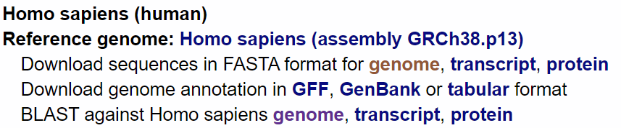
Task #3
Compute the GC content
Solve Rosalind #gc: Computing GC Content: http://rosalind.info/problems/gc/
Download the FASTA sequence and compute the GC contents of either of the following fruit fly genes:
Swiss Cheese
Ken and Barbie
Cheap Date
Download the complete human genome from NCBI Genome database
Go to https://www.ncbi.nlm.nih.gov/genome
Search for Homo Sapiens (https://www.ncbi.nlm.nih.gov/genome/?term=Homo+sapiens)
Download the full genome sequence by clicking at “genome” (shown):
What is the GC content of the human genome? Is it eqaul across the chromosomes?
How many genes are there in each chromosome?
How many protein coding genes are there in each chromosome?

Slide 11
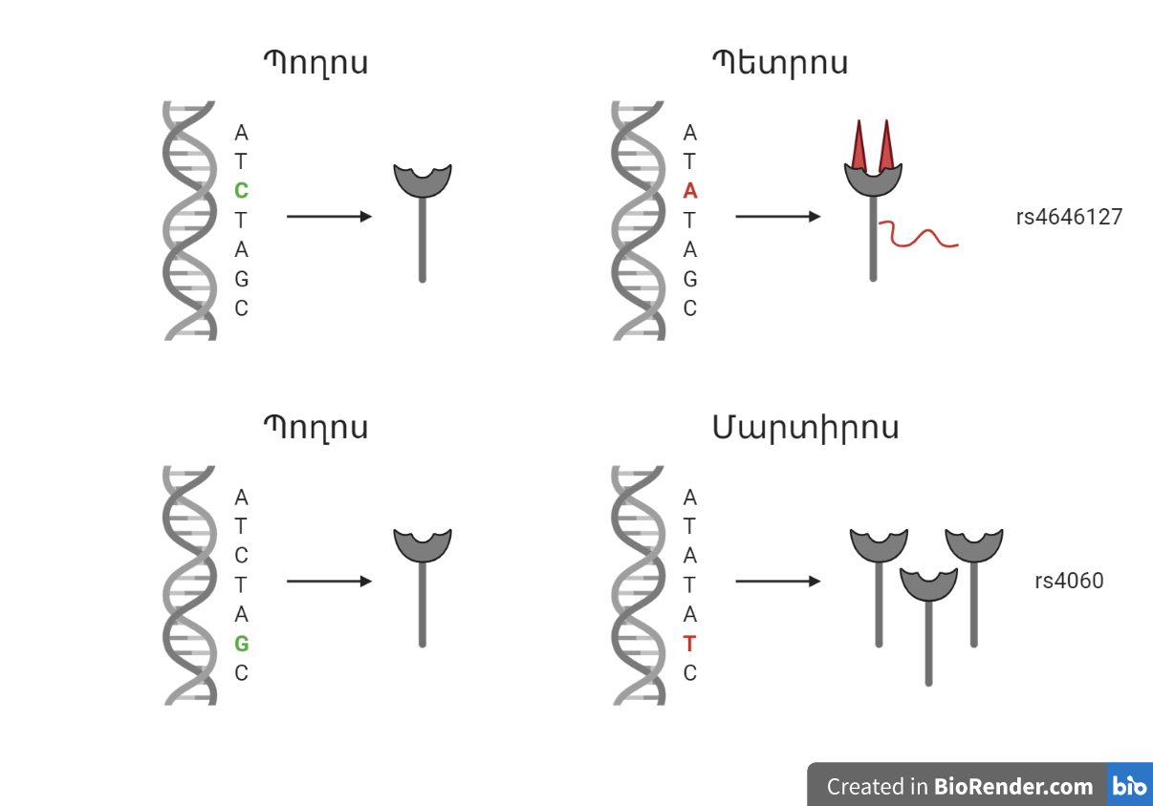
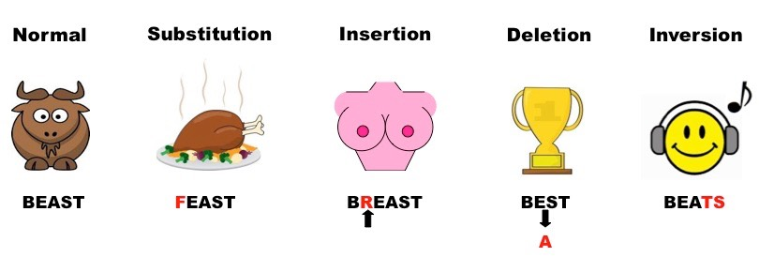
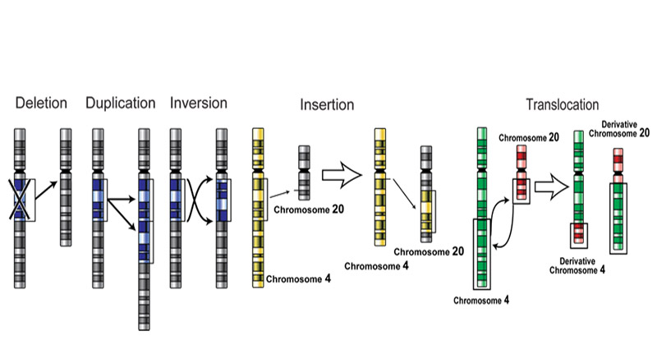
Mutations and genomic variations
Types of mutations
A mutation or genomic variation is a change in DNA sequence.
There is also another definition for a mutation that distinguishes it from common genetic variants (polymorphisms), and may be simplified as:
- A mutation is a genomic variation that occurs in less than 1% of a population.
- A polymorphism (e.g. SNP = single nucleotide polymorphism) is a genomic variation that occurs in more than 1% of a population.
NOTE: The definitions may vary and it is always important to understand the context and usage of the words variant, mutation and polymorphisms.

Slide 12
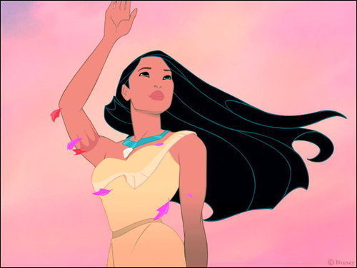
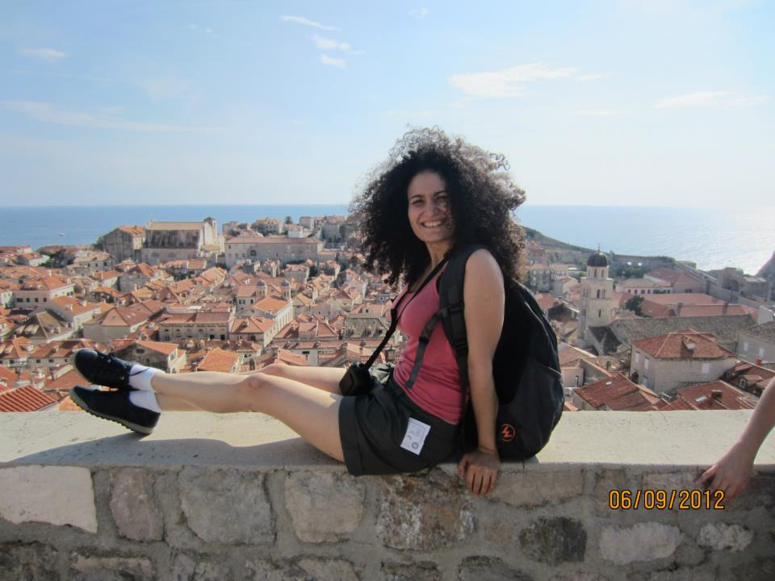
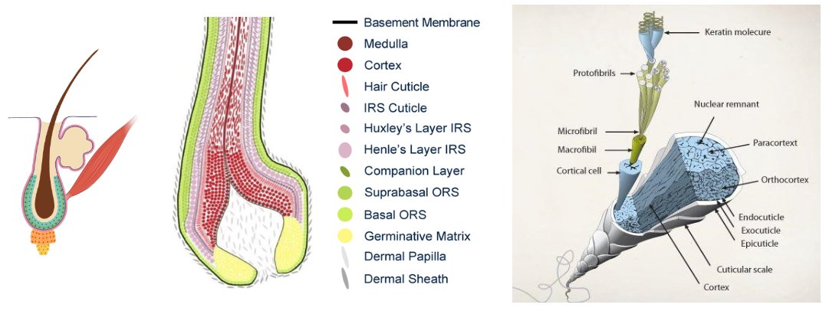
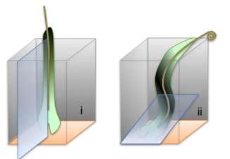
Curly hair: a genetically defined phenotype?
Expectations
Reality
Genome wide association studies linking several genes to curly hair.
Protein biomarkers SNPs | Localisation | Asymmetry
K38 | Cortex | Earlier expression on concave side
K82 | Cuticle | Later expression on convex side
Ki67 | Bulb matrix | Proliferation is above the line of “Auber” on the convex side
K14 | ORS | ORS is thicker on the concave side
IGFBP‐5 | ORS | Greater expression on convex side
K74 K74 SNPs | IRS | Mutations give rise to woolly hair rs3912631, <3×10⁻⁰⁵
K71 | IRS | Mutations give rise to woolly hair and curly hair in dogs
Trichohyalin TCCH SNPs | IRS | SNP associates with straighter hair in Caucasians Afd_1108920a <1×10⁻⁶
Fibronectin | CTS | CTS is thicker on the concave side shown by fibronectin staining
CUTC CUTC SNPs | IRS | Copper transport homologue. Copper changes linked to wool crimp in sheep and “kinky hair” in Menkes disease Copper deficiency produces less crimp in wool rs4919394 <5×10⁻⁷ rs978554 <9×10⁻⁷ rs7078602 <1×10⁻⁶
HSPG/CSPG | CTS | PGs absent in CTS facing matrix cells
Hair
follicle
Look up at NCBI SNP db: https://www.ncbi.nlm.nih.gov/snp/rs3912631
https://doi.org/10.1111/exd.13347

Slide 13
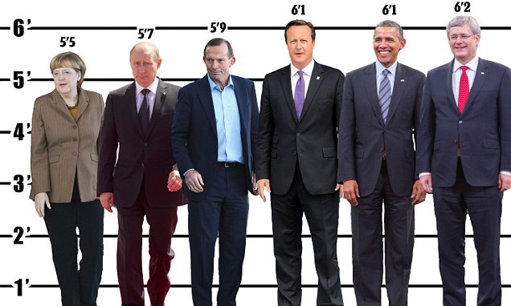
Height is also a complex trait defined by more than 400 genomic variations!

Slide 14
The genes are switched on and off depending on cell type, internal and external conditions and genomic variants
Gene expression
When a gene is used to make an RNA and protein, we say the gene is expressed or turned ON. The different cell types in our bodies have different genes expressed or switched ON.
© Ribosome Studio
https://www.facebook.com/RibosomeStudio/posts/559703991189935

Slide 15
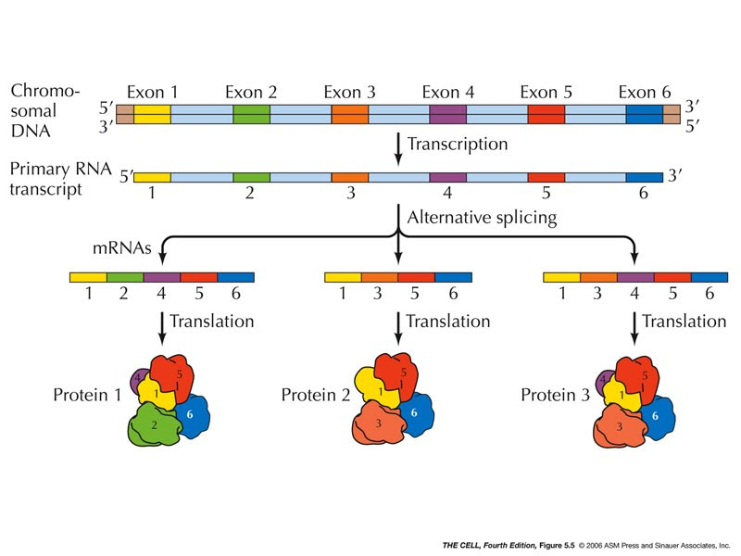
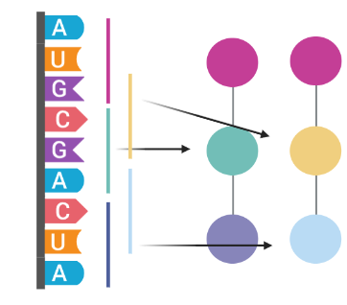
Many ways to read the same DNA sequence
Alternative splicing
Not all the sequence fragments in a gene are included in the RNA. The selective inclusion of certain fragments depends on different factors and is called alternative splicing.
Ribosome frameshifting
The RNA may also be read in different ways during translation. The translational frame defining the 3-nucleotide (codon) positions may change, leading to a different protein.

Slide 16
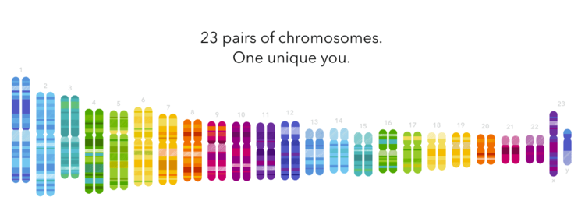
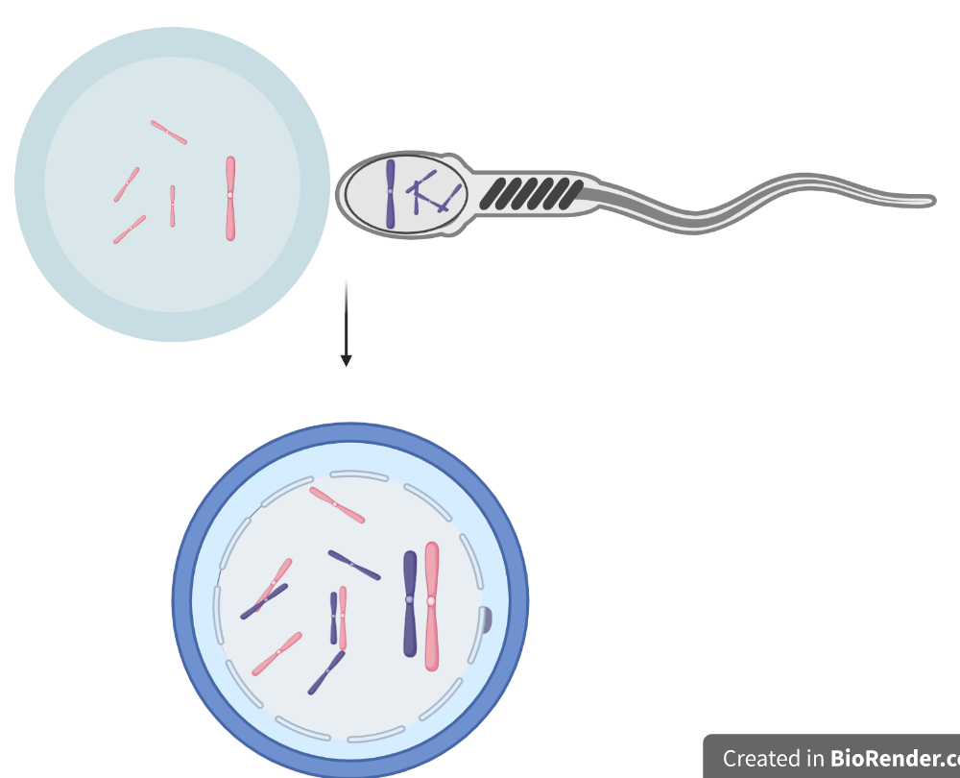
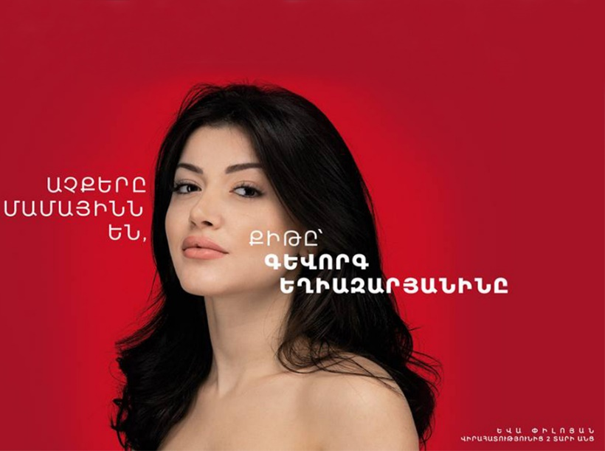
Heredity
maternal
paternal
© 23andme

Slide 17
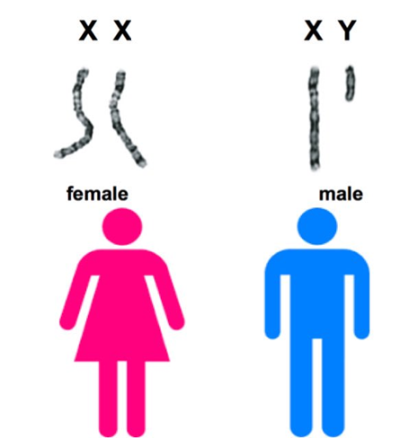
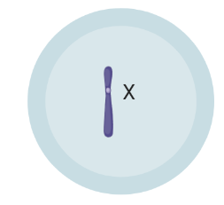
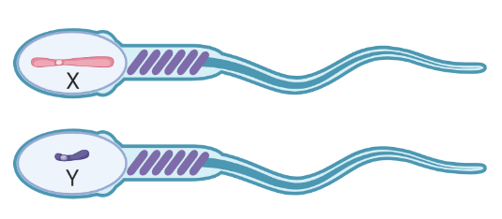
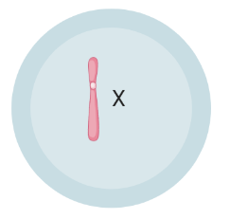
Sex chromosomes
© 23andme
During formation of sexual cells or gametes (eggs and spermatozoa), the maternal and paternal chromosomes are randomly distributed to the two gametes. The female eggs contain an X chromosome each, either inherited maternally or patternally. The male sperm contain either a maternally inheritted X chromosome or a paternally inheritted Y chromosome.

Slide 18
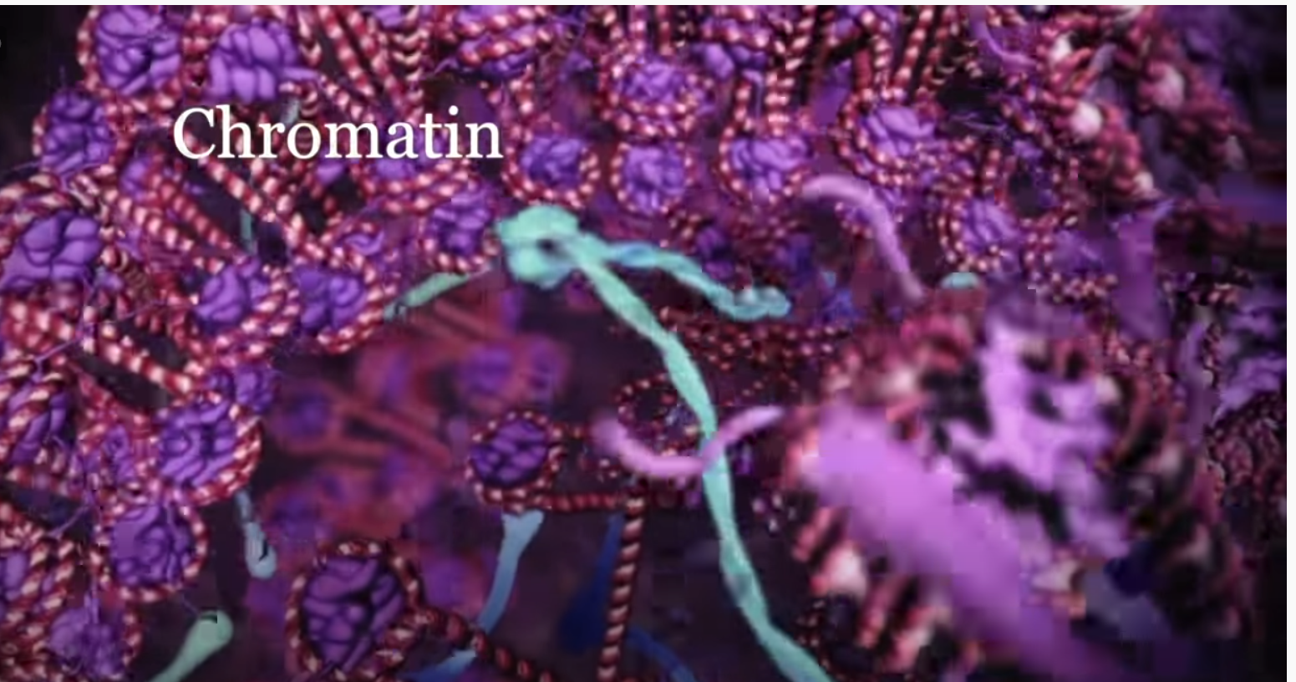
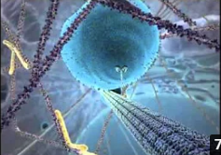
Two great animations
Your Body's Molecular Machines
The inner life of a cell
https://www.youtube.com/watch?v=X_tYrnv_o6A
https://www.youtube.com/watch?v=FzcTgrxMzZk

Slide 19
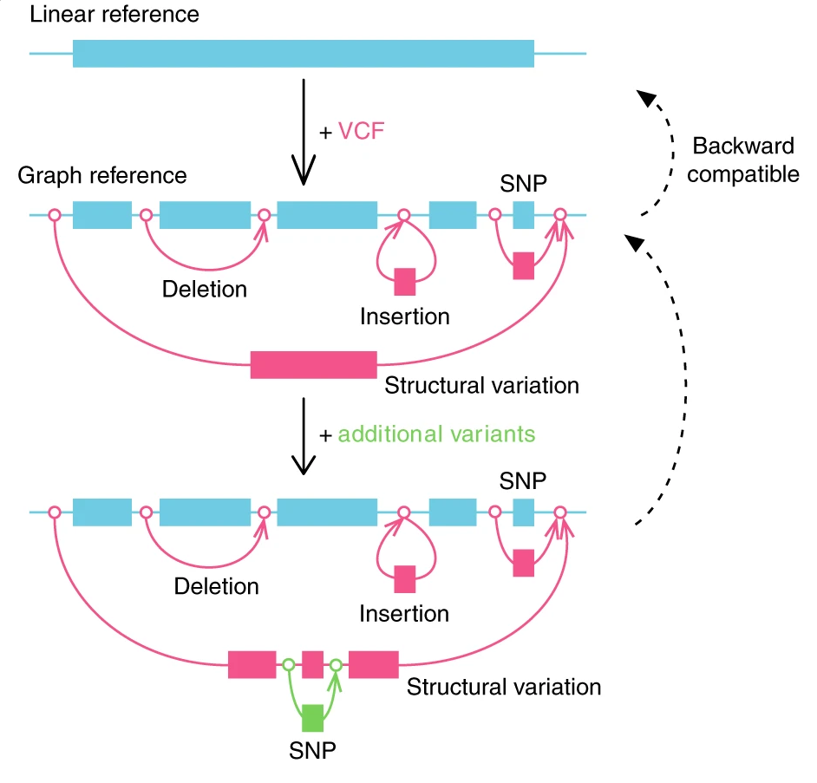
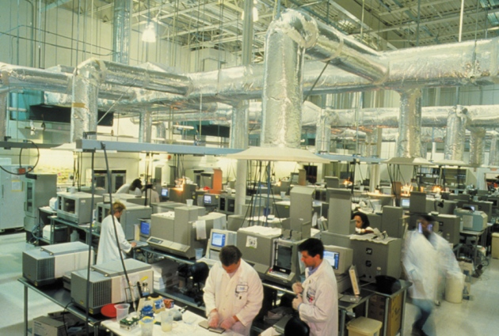
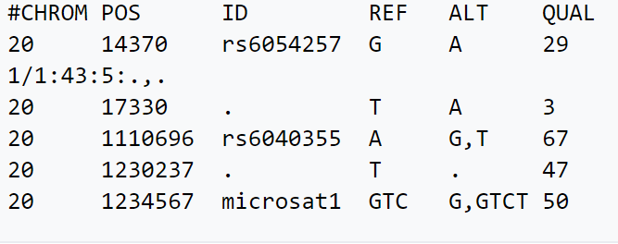
The human genome project and reference human genome
How to store variations in the genome?
1990-2003
2003:$3․8 bln
2010: 5.6$ bln
Graph genome
https://doi.org/10.1038/s41588-018-0316-4
>linear reference genome sequence
TCAGTTCGGTTTCGTTGGCGATCGCGAACGGAGCGCAGACGAAACGCGCGGTATTTGGATCGTGGCAAGA
AATAAAAACAACAACATGCTGAAACCGTATACTTAATACGCGTGTGTGTAGCTCAAAAACAAGAAAAATA
TAAATAAACAAAACTACATTGCTACGTCAGAAGACTGCAAACAAAAGATATGAACGCAGCGCGCTGAGCT
GCTCTTGACGTCGCCGCCAAGGTTCGAATCAGATATATTTTCTCTATTTTTTATTTTTTTTTCCGCCCAT
TTTTGTGTTGTTTTTAATAAGCTTACAACTTTACAAGTGTTTTTTGTTGTGATTTTTGTACTTTCGTGAG
TGATTTGTGATTTGCGATTTGCGTGCAGTTGAAGGCGAGGAGAACTGCATTCGATCTTTCCGATCAGCAG
Variant call format (VCF)

Slide 20
Thank you
Course github repository: https://github.com/lilit-nersisyan/bioinf-2020
Next topics:
Sequencing technologies
Sequencing data analysis

Slide 21

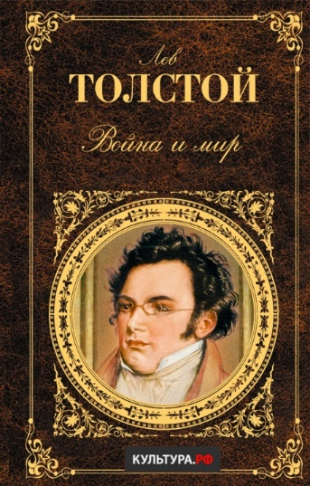
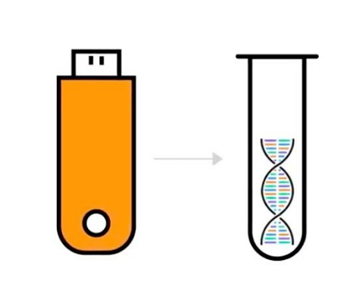
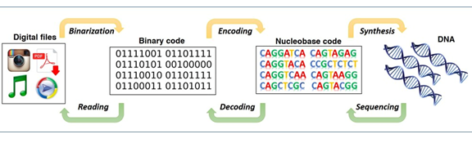
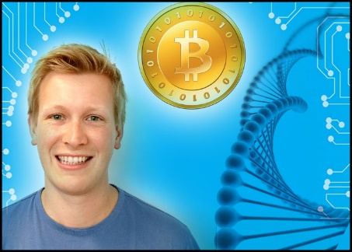
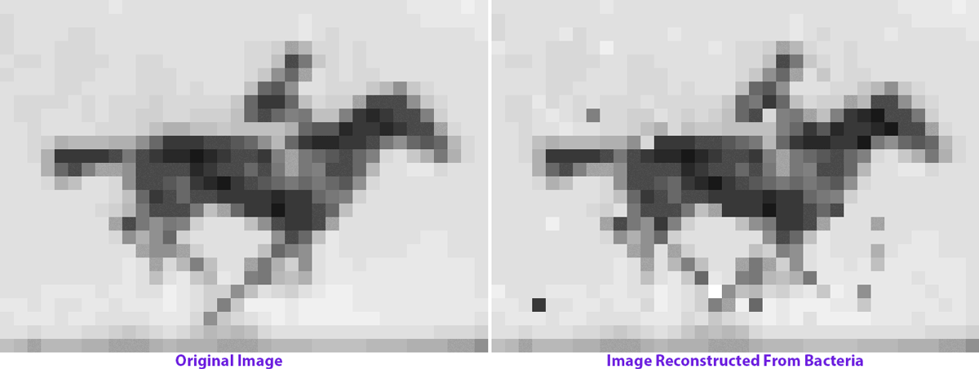
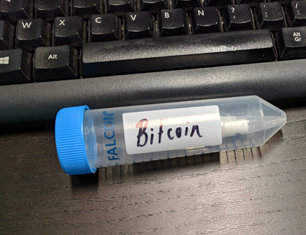
Using DNA as an information carrier
587,287 words of War and Peace and 99 other classics.
January 21, 2015, Nick Goldman from the European Bioinformatics Institute (EBI)
Sander Wuyts, PhD, Belgium
19 January 2018 around €9500.

